Slide 1

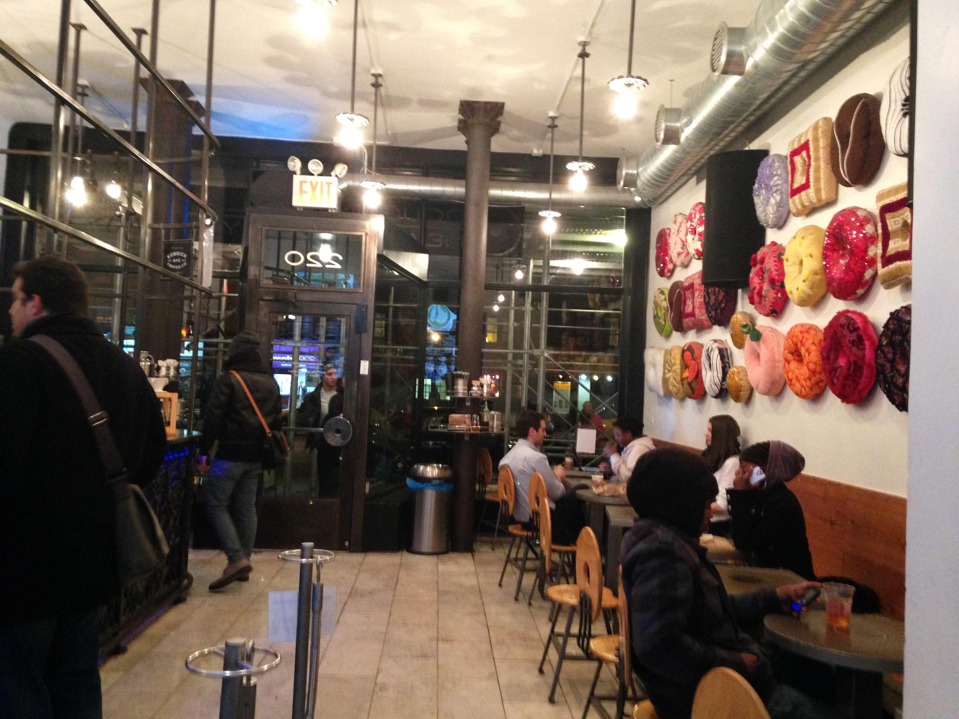
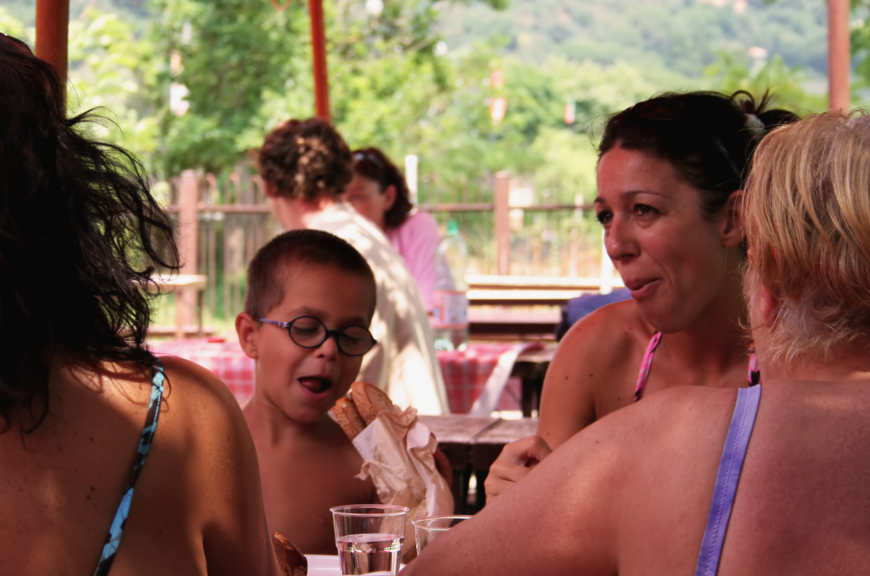



Home Menu About Us Contact
Donut Delights
The finest in breakfast treats and coffees since 1971
Donut Delights has been serving C-U with the highest quality donuts and coffees since 1971. Nestled in downtown Urbana, Donut Delights has become a haven for “Gotta have it” breakfast treats. Our donuts are baked fresh twice daily and our coffee’s brewed every fifteen minutes. If you have never been to C-U’s hidden gem, you are missing out.
Fun donut fact:
January 12th is National Glazed Doughnut Day.
© 2018 Donut delights

Slide 2
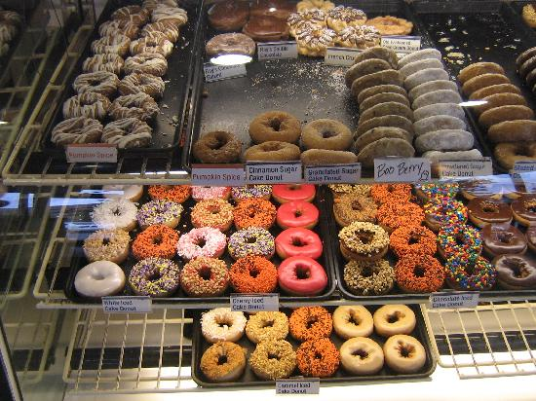
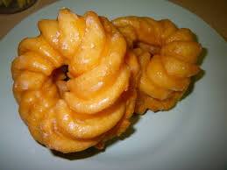
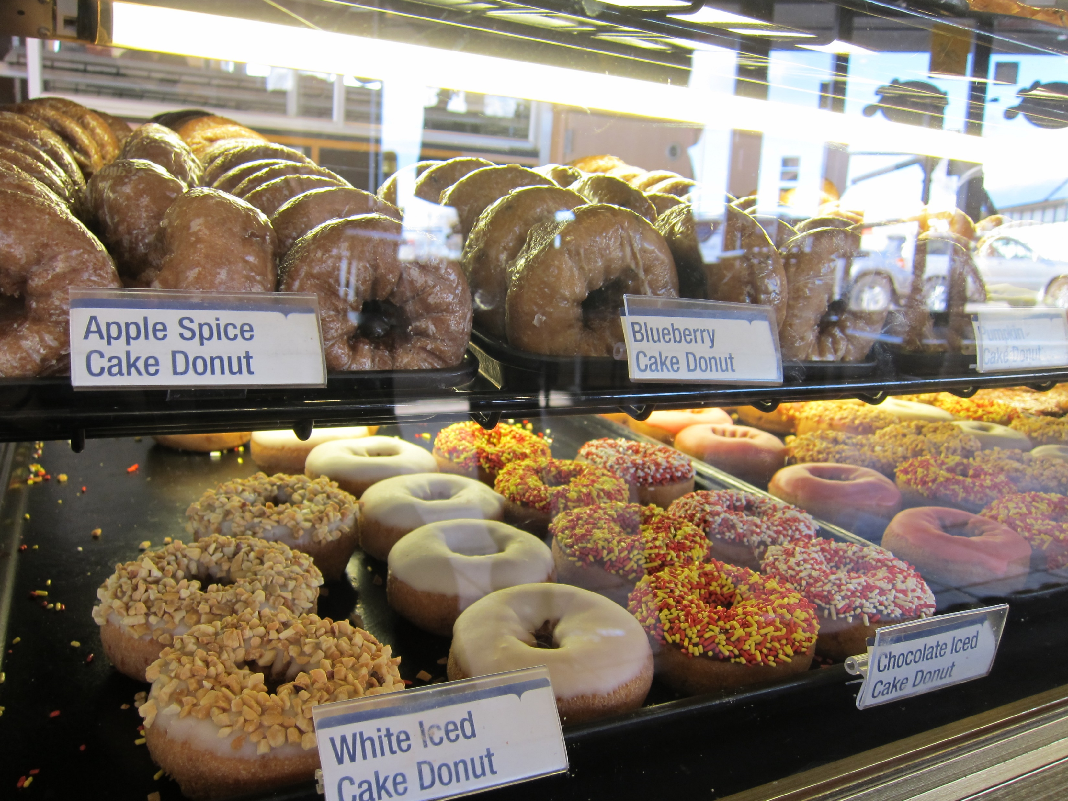
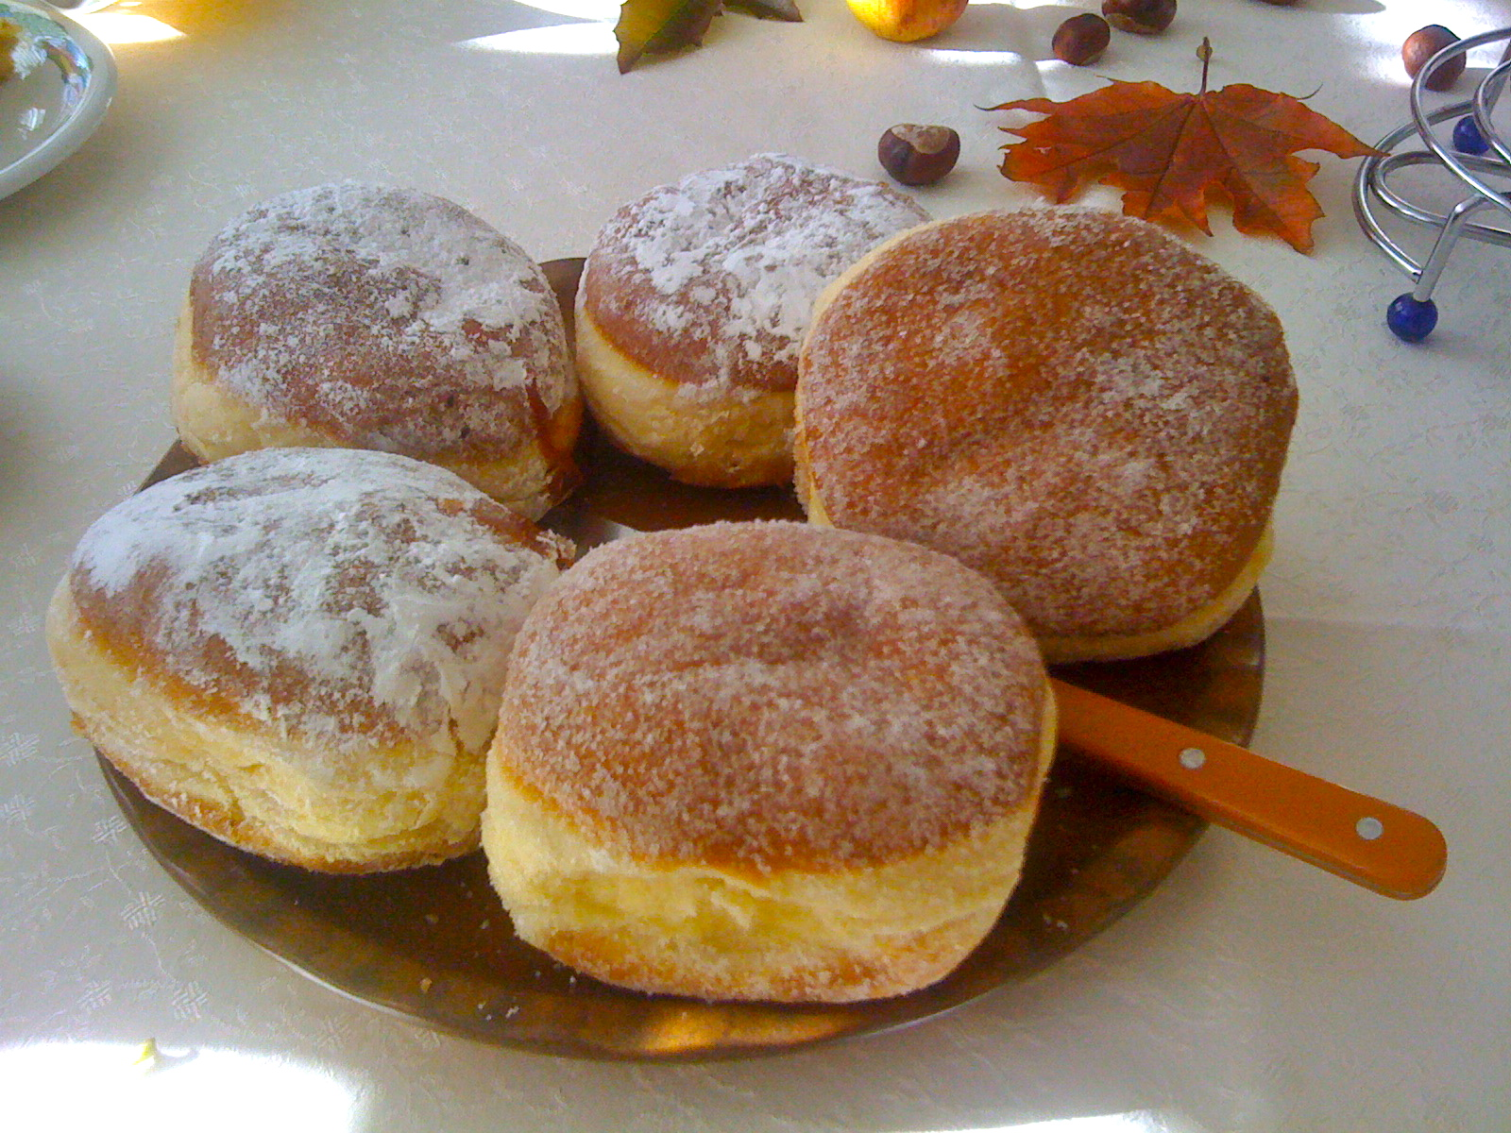

Home Menu About Us Contact
Regular donuts:
Chocolate frosted
Vanilla frosted
Boston cream
Jelly filled
Glazed
Marble twist
Sugar raised
Plain donuts
Plain cruller
Honey wheat
Jelly puff
Cream puff
Coffee roll
Fancy donuts:
Bow tie
Éclair
Apple turnover
Fancy coffee roll
Single: $2.00
French cruller
Single: $2.00
Bakers Dozen: $8.65
Single: $1.05
© 2018 Donut delights

Slide 3
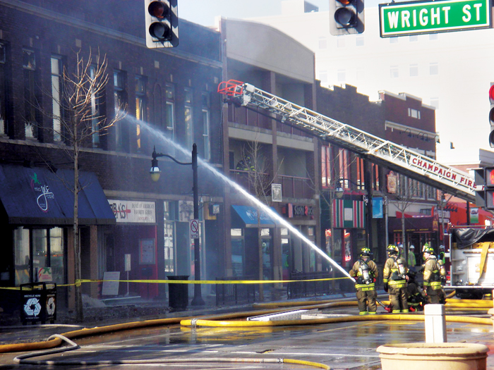
Home Menu About Us Contact
About Us:
Donut Delights was started in 1971 by Melvin Furballski, an immigrant baker from the far east coast of Poland. Known far and wide for his delicate pastries, Melvin fled his homeland in search of a better life for his family. In 1970 he landed in New York City and by chance he found an open seat on a bus heading west. When an unexpected mechanical failure forced a three day delay in Champaign, Illinois, Furballski saw the need for a donut shop, so he decided to stay and make a new life for himself in Urbana, Illinois. With only one hundred dollars to his name, he found an abandoned bread shop and within two days he had one of a kind donuts flying off the racks faster than he could bake them and things have never slowed down. Now you can find that same great donut recipe plus dozens more still being made with the same love and care as when Donut Delights first opened. A bakery fire in the mid-1980s destroyed many of the shop's records...but NOT THE RECIPES. While many people might have viewed the fire as an excuse to quit, Melvin instead used it as an opportunity to reconfigure the interior design, allowing him to add the coffee roastery section as well. So when you visit, be prepared for the inviting mix of aromas from fresh-roasted coffee beans and fresh-baked donuts: It's the closest thing to "Breakfast Heaven" anywhere in the C-U area
© 2018 Donut delights

Slide 4
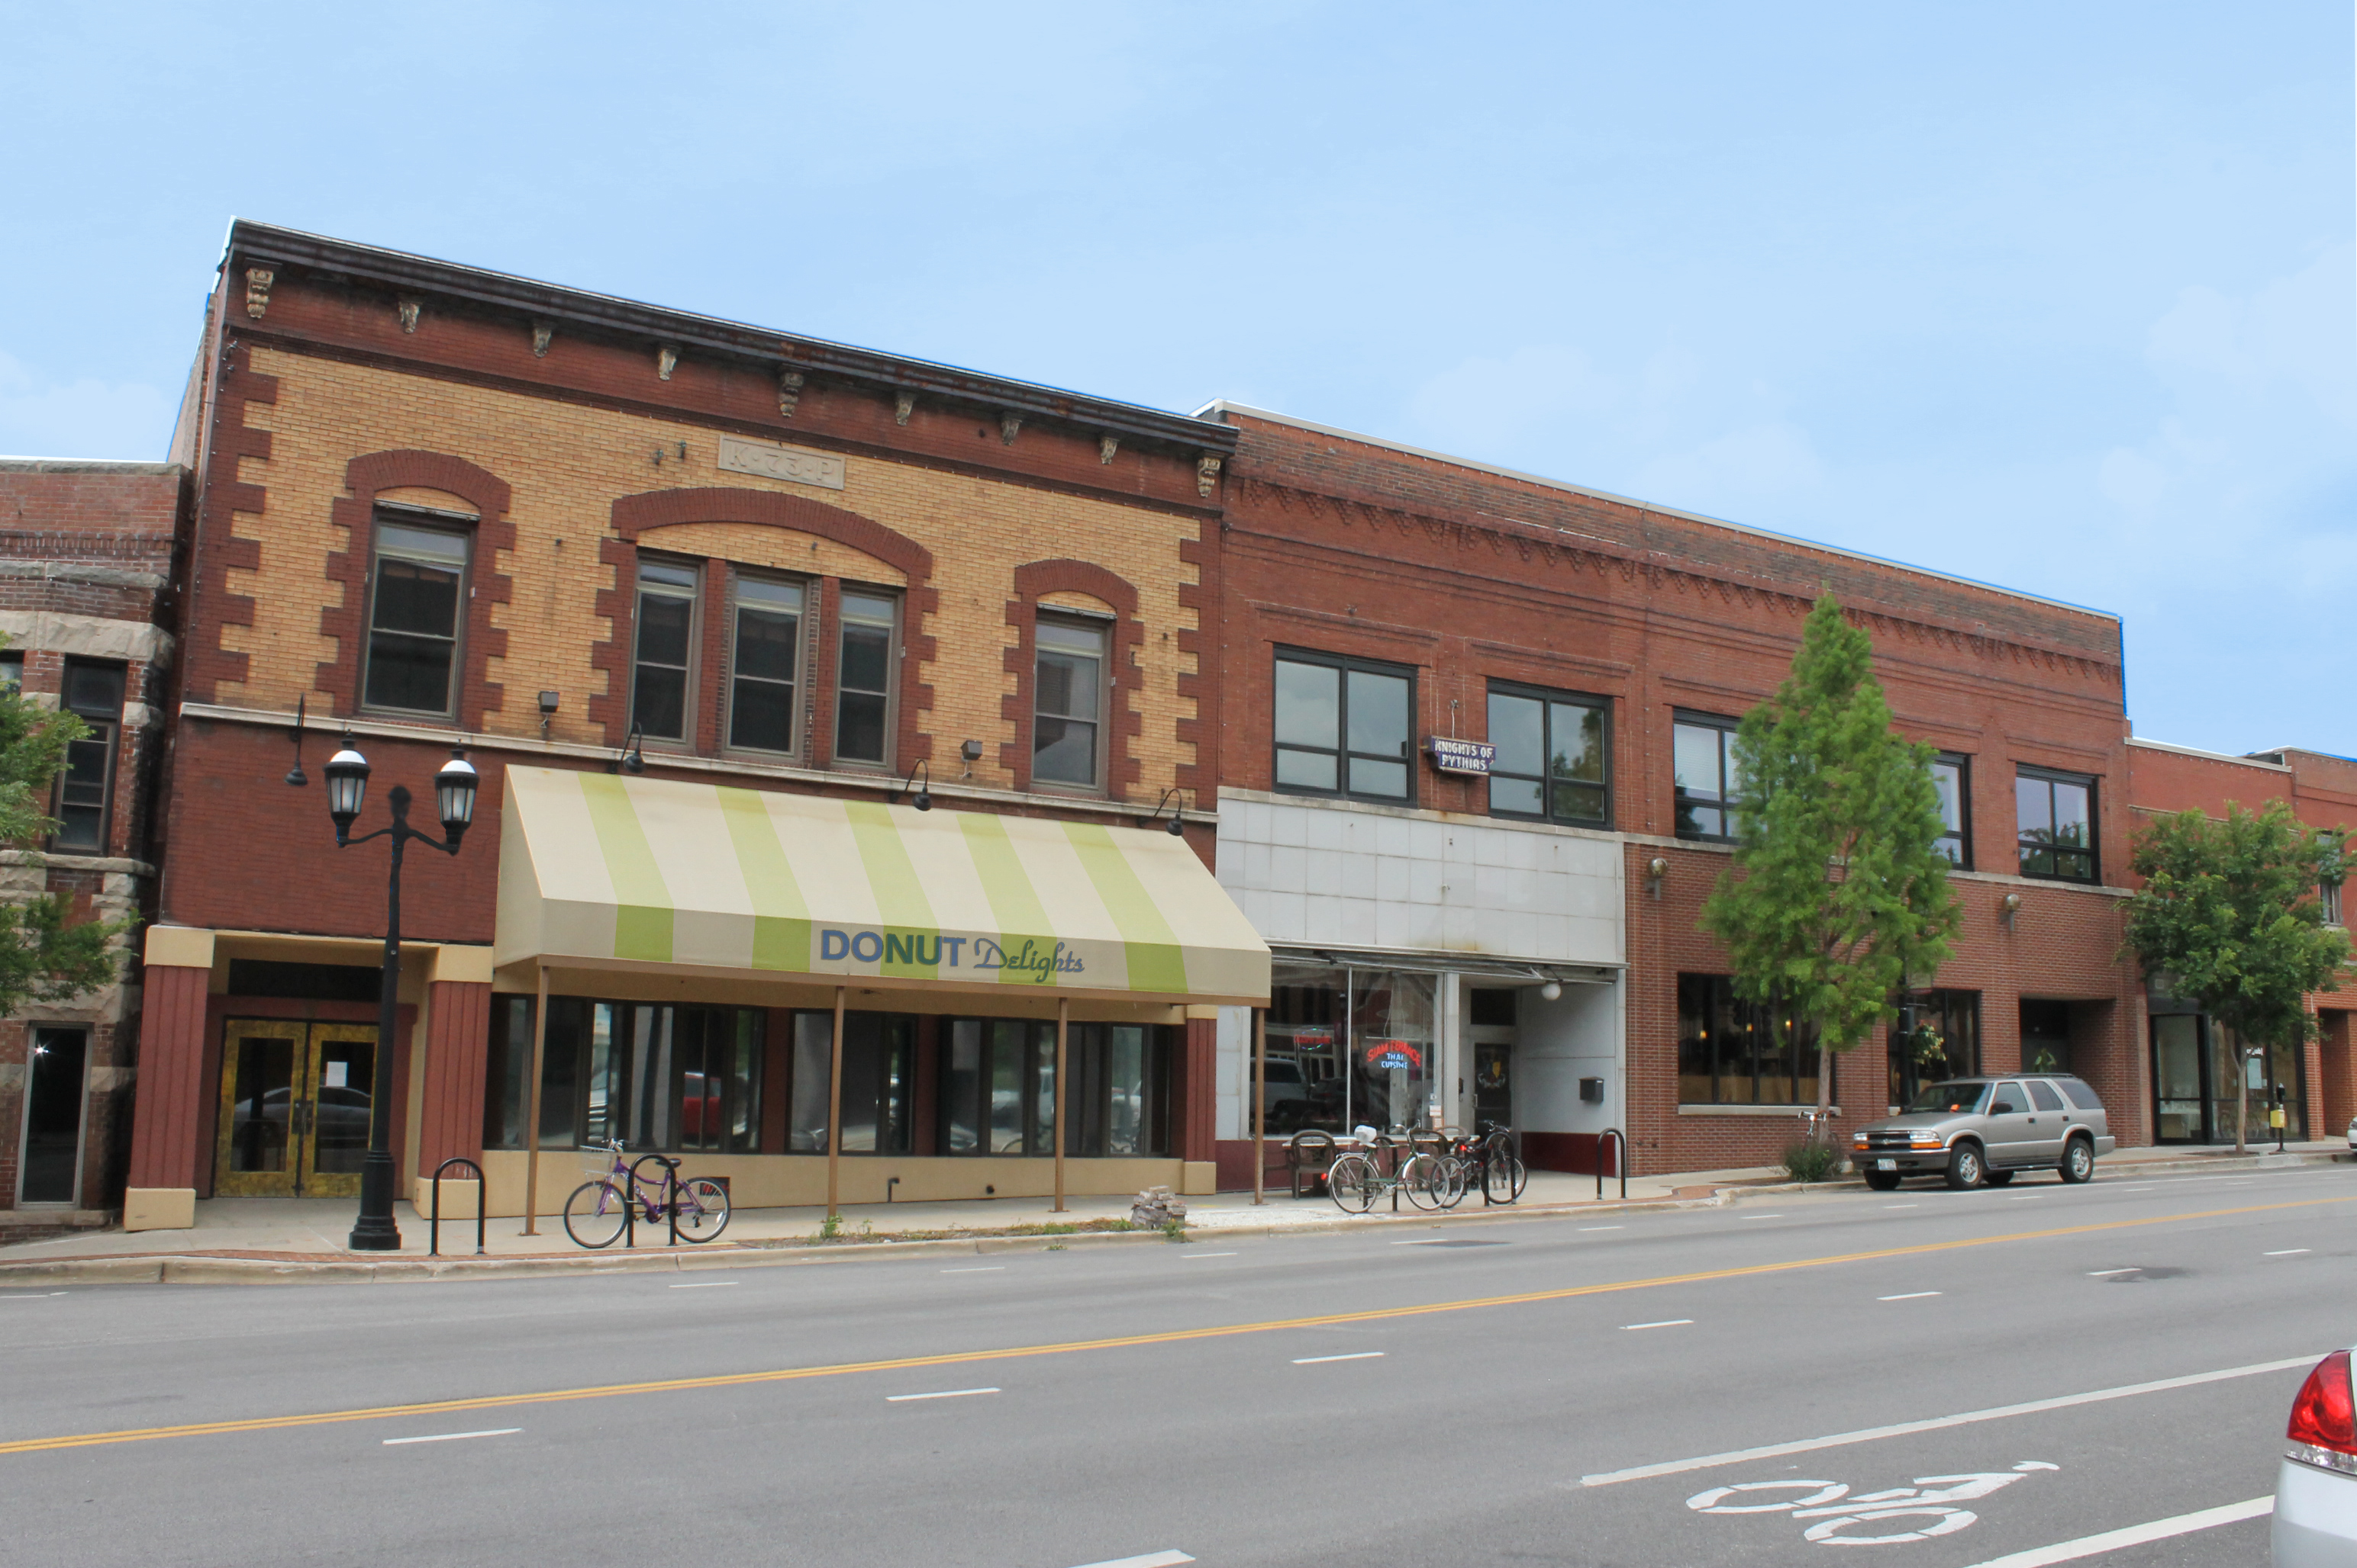
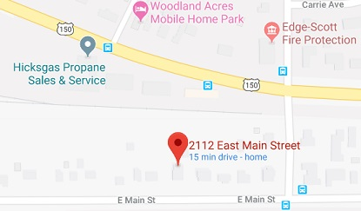
Home Menu About Us Contact
We are located in Urbana Illinois on 2112 Main Street
Our phone number is:
(217)-555-1234
Our email is:
contact@donutdelights.com
Hours:
Monday: 5:30am-4:00pm
Tuesday: 5:30am-4:00pm
Wednesday: 5:30am-4:00pm
Thursday: 5:30am-4:00pm
Friday: 5:30am-4:00pm
Saturday: 8:00am-4:00pm
Sunday: 8:00am-4:00pm
Sign up for our weekly email list to get notifications about special events we have going up as well as special deals just for our newsletter subscribers.
Enter email here:
Fun donut fact:
The first Friday in June and November 5th are National Doughnut Day.
© 2018 Donut delights

